Slide 1
Generic Data Structures
Avoiding rewriting for different types

Slide 2
Strongly Typed Data Structures
  Strongly typed data structure: data structure that can only hold a specific type of data, e.g.:
    LinkedList that can only hold Strings
    DynamicArray that can only hold ints
  Strongly-typed structures are caused by specifying the only type that can be stored within the structure’s class
    DynamicArray containing : int [] data
    LinkedList’s Node class containing : String data
  Strongly typed structures can also be caused by specifying the only type that can be taken in as a parameter or returned as a result
    DynamicArray add method : public void add(int newData)
    LinkedList get method: public String get(int pos)

Slide 3
Strongly Typed Structures: Pros
  Strongly typed structures can be customised to exactly the behaviour you need
    You know exactly what information will be in the data being stored
    You know exactly what methods you can use on the data
  Strongly typed structures can be reused very conveniently for hierarchies of types
    All subclasses of the original type can also be stored within a strongly typed data structure*
Notes:
However, when they are RETRIEVED from the data structure, they will need to be cast back to their original types before being used fully (and you will need to confirm that they were created as the correct type before carrying out that casting) E.g.:
Person p = myLinkList.get(i);
if(p instanceof Student){
Student s = (Student) p;
System.out.println(“Student’s GPA: “ + s.getGPA());
}

Slide 4
Strongly Typed Structures: Cons
  Strongly typed structures can only be used for the type (and corresponding subtypes) it was written for
    Every time you want to use a Linked List for a different type, you need to write a new Linked List implementation
  This can lead to a lot of code duplication

Slide 5
Moving Away From Strong Typing
  How can we avoid writing strongly typed data structures?
    Don’t specify the type of data stored
    Don’t specify the type of data being taken as a parameter
    Don’t specify the type of data being returned as a result
  But we have to say SOMETHING about the data being used
    Compiler needs to confirm that all the types are consistent
    Compiler needs to confirm the types work together correctly
    Essentially all we need to say is all the types match…
NO TYPES

Slide 6
Generics – Using Type Variables
  We need consistency across types within a data structure
  We want to let this type be anything* the programmer needs it to be
  Solution: Set the type to be a variable
  Every time we need to specify the type, use the variable instead
    When the variable is finally set (i.e. when the programmer creates a data structure) every type within the class will match
Notes:
With acceptable characteristics – we’ll see more on this later

Slide 7
Generics: From the Calling Code Side
  To create an ArrayList:
    ArrayList<Person> myPeopleList = new ArrayList();
  Angle brackets set the type variable for that ArrayList
    When the ArrayList is created in memory, it will be set up to work with the Person class
      get() will return a Person
      set() will take in a Person

Slide 8
Writing Generic Code:
The Basics
  To write a class that uses a variable type, you must:
    Set the type to a specific variable at the top of the class (using angle brackets <>)
      Instead of public class LinkedList, public class LinkedList<E>
    Use the type variable as return / parameter types where needed
  Rule of thumb:
  Use type variable (e.g. E) (from top of the class) wherever you would have used a specific type (e.g. int, String etc)

Slide 9
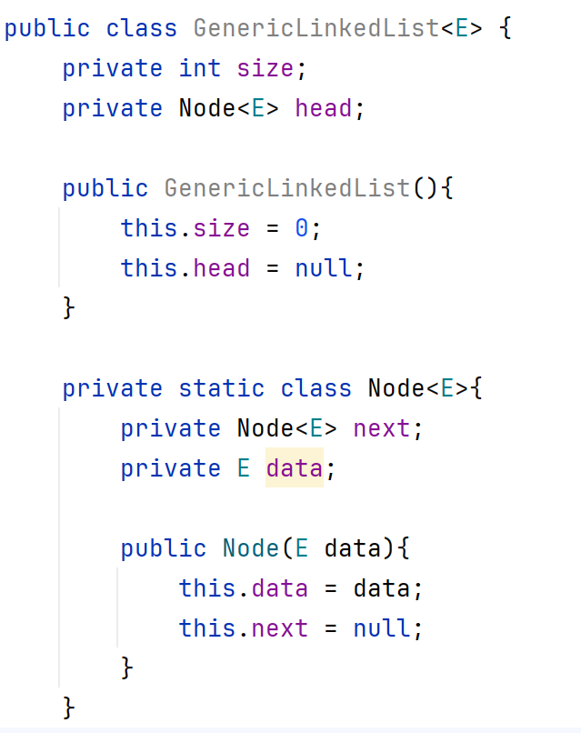
Employing Type Variables to Implement LinkedList
  Defining a generic LinkedList:
    Include type variable in class signature
    Declare Node using type variable
  Defining a generic Node:
    Include type variable in class signature
    Create internal Node storing next reference using type variable
    Create & use data variable as variable type

Slide 10
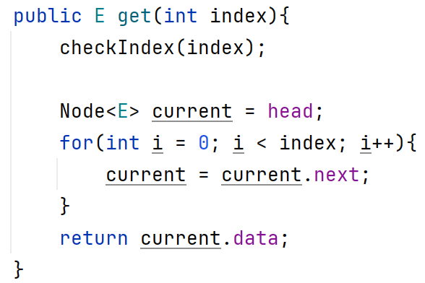
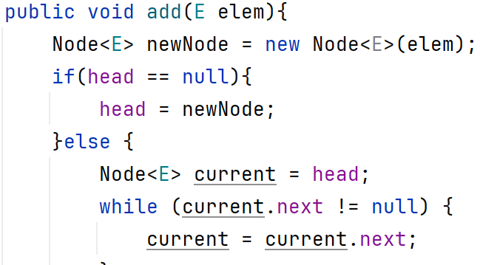
Working With Type Variables in LinkedList
  Moving through list:
    Declare Node using type variable
  Retrieving from list:
    Specify return type using type variable
    Declare Node using type variable
  Adding element to list:
    Specify method parameter as type variable
    Create and declare new node using type variable

Slide 11
The Complicated Nature of
Array-Based Data
  Unlike classes, arrays cannot be created using type variables
    E [] data = new E[size]; <- can’t do this!
  This is because arrays store type information, but generics are built on type erasure
    The virtual machine (JVM) needs to know the real type to build an array at runtime
    Generic type variables compile to Object*, no real type information is available

Slide 12
To Cast an Object:
Creating Generic Array-Based Structures
  Three main aspects required:
    Create an Object array to store the information
    Cast data read from the array
    Suppress unchecked warnings from the compiler!
  Why don’t we need to validate parameter types on intake?
    Compiler will type check and confirm objects being added are correct type

Slide 13
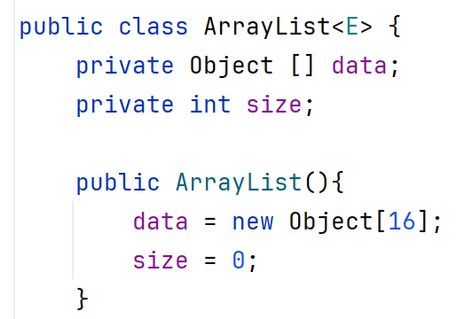
Generic ArrayList:
Step 1) Internal Object array
  Store data in Object array
    No use of type variable on array
  All classes inherit from Object, so all types can be stored as an Object
    This includes ints, doubles etc!
    Autoboxing converts primitive types to their Object equivalents
      E.g. int -> Integer, char -> Character

Slide 14
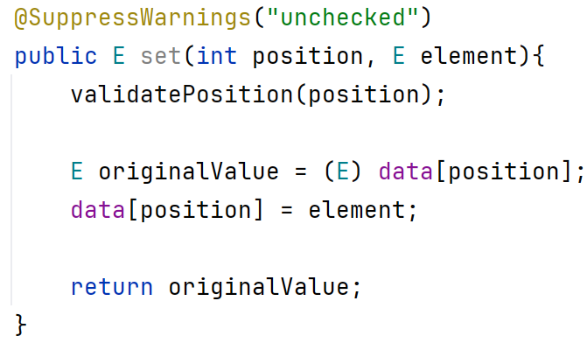
Generic ArrayList:
Steps 2 & 3: Extracting Data From Array
  When reading from the array:
    Extract the data
    Cast it to the variable type
  Unless we want to fill the code with type checks, we add a cheat: @SuppressWarnings
    Remember: Thanks to the compiler, we know the data is the right type!

Slide 15
The Problem With Generics
  Sometimes we need our data to have specific abilities
    E.g. if we wish to be able to compare/rank two instances, their class (i.e. their type) must implement Comparable
  Type variable on a data structure means ANY type will be accepted and worked with within that structure
    What if we want to be able to sort the contents of the structure?
  Solution: add a restriction/requirement to the type

Slide 16
Restricting Acceptable Types
  To restrict the types that can be used in a class, specify that they must extend a specific class
  Notation: <TypeVariable extends DesiredClass>
    TypeVariable: The variable we’ll use throughout the data structure to indicate the type of information we’re working with
    DesiredClass: The most general version of the class with functionality we need.
      Any subclasses of DesiredClass will also be acceptable for use in this structure
  Example: Say we want to build a linked list that can store any sort of worker so we can perform wage calculations across the entire list
    Instead of: public class LinkList<E>
    Use: public class LinkList<E extends Worker>

Slide 17
Restricting Acceptable Types By Interface
  You can also restrict data types based on the interfaces they implement
    This is particularly useful for structures that want to perform non-standard actions across their information
    E.g. You can guarantee that the Comparable interface is implemented by what you’re storing, allowing you to sort the data within the structure
  Implementing this restriction uses the same extends notation we saw before:
    <TypeVariable extends InterfaceName<TypeVariable>>
    E.g.: public class LinkList<E extends Comparable<E>>
  Note: The interface is only set with the type information if that interface is also generic
    Comparable is a generic interface, public interface Comparable <E>, therefore you also need to set what type of information will be compared. If this is not included, the data involved will always default back to Object
Note that you do NOT use the implements keyword!

